Slide 2
Dear Jason,
I know your deeds.
Love, Jesus.

Slide 3
Ephesus:
@ 1st

Slide 4
Revelation 2: 1-7 NIV
1 “To the angel of the church in Ephesus write: These are the words of him who holds the seven stars in his right hand and walks among the seven golden lampstands. ² I know your deeds, your hard work & your perseverance.
I know that you cannot tolerate wicked people, that you have tested those who claim to be apostles but are not, and have found them false.

Slide 5
³ You have persevered and have endured hardships for my name, and have not grown weary. ⁴ Yet I hold this against you: You have forsaken the love you had at first. ⁵ Consider how far you have fallen! Repent and do the things you did at first.
If you do not repent, I will come to you and remove your lampstand from its place.

Slide 6
⁶ But you have this in your favor: You hate the practices of the Nicolaitans, which I also hate. ⁷ Whoever has ears, let them hear what the Spirit says to the churches. To the one who is victorious, I will give the right to eat from the tree of life, which is in the paradise of God.

Slide 7
Evaluation Time!

Slide 8
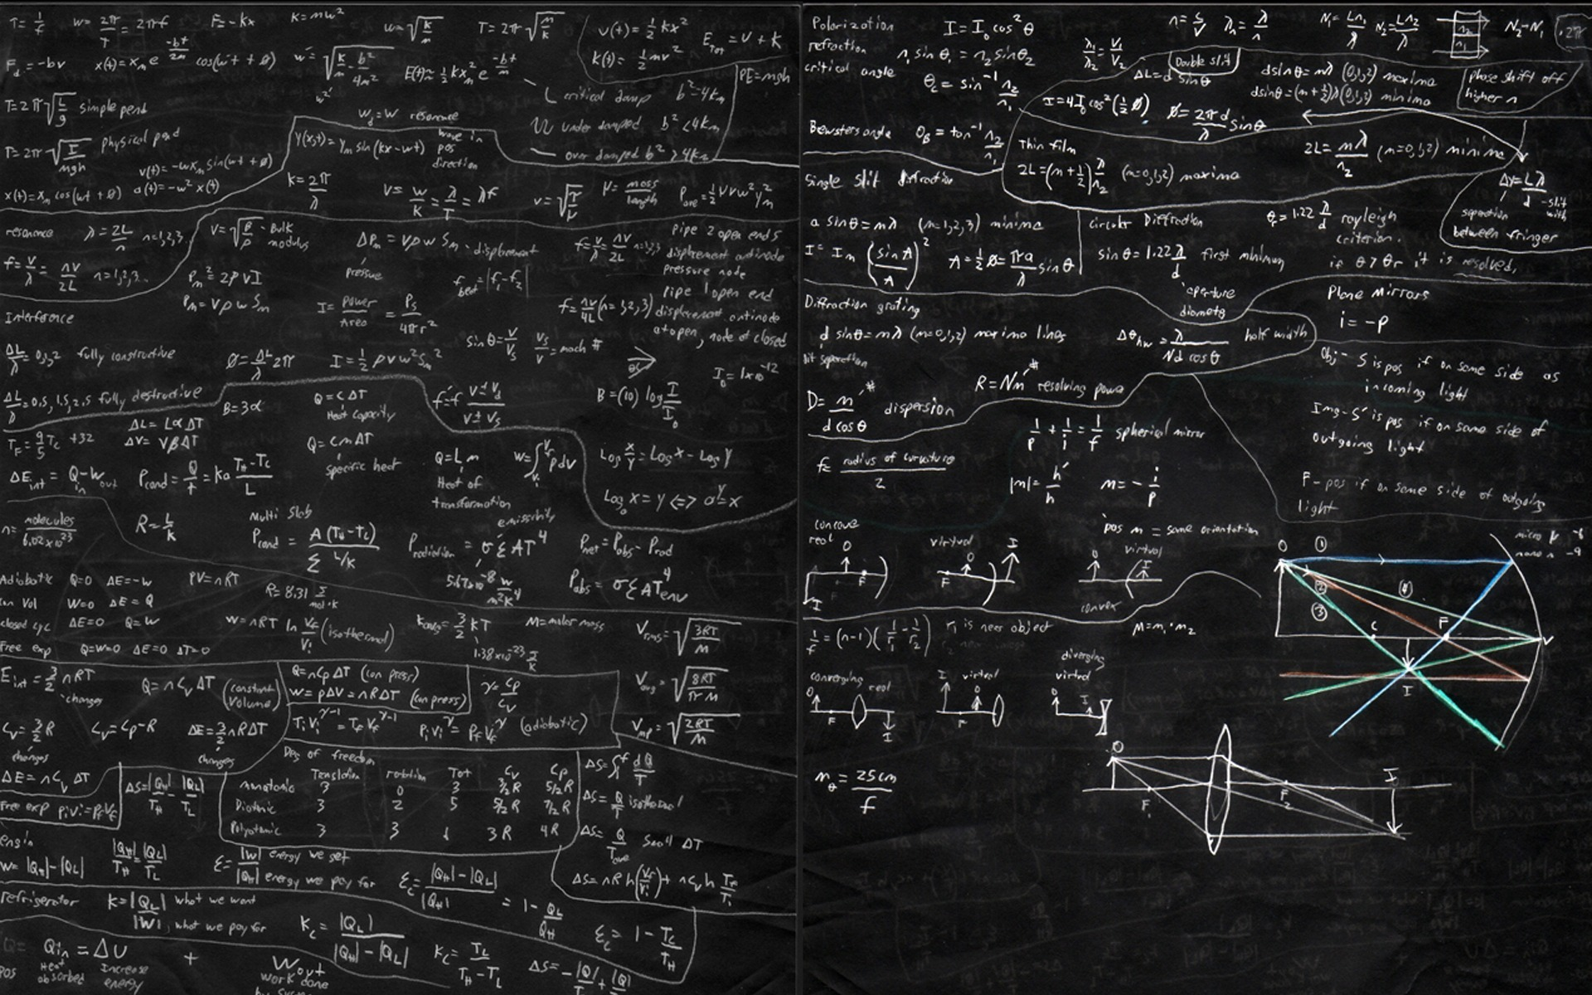
Remember +
Repent +
Re-Love =
Re-Connection

Slide 9
Remember!

Slide 10
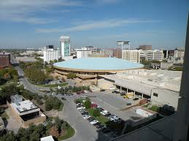
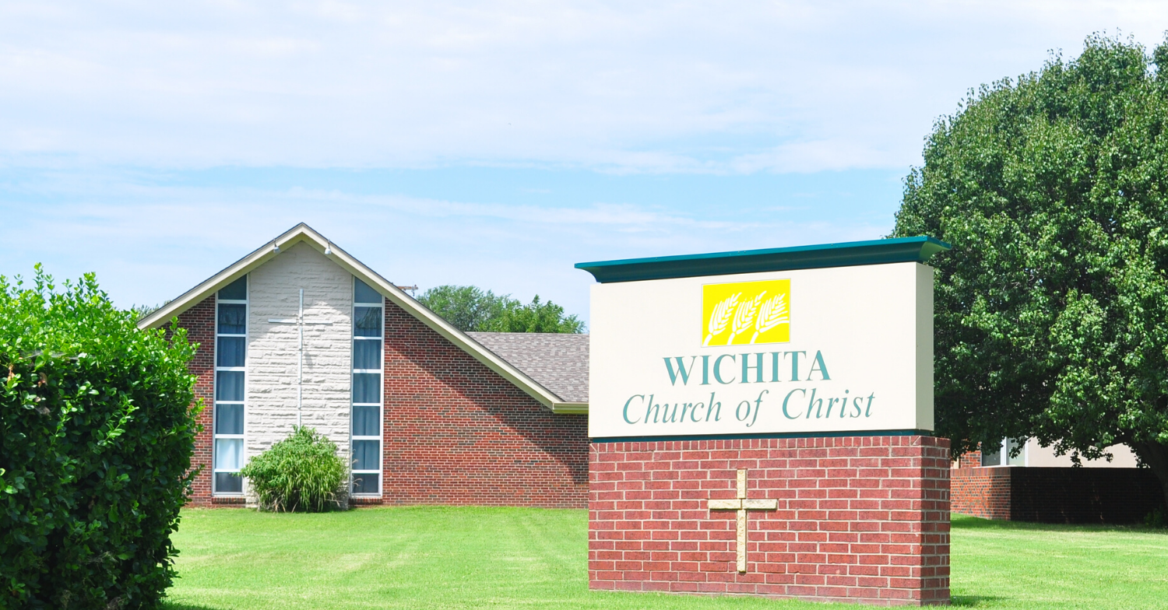

Slide 11
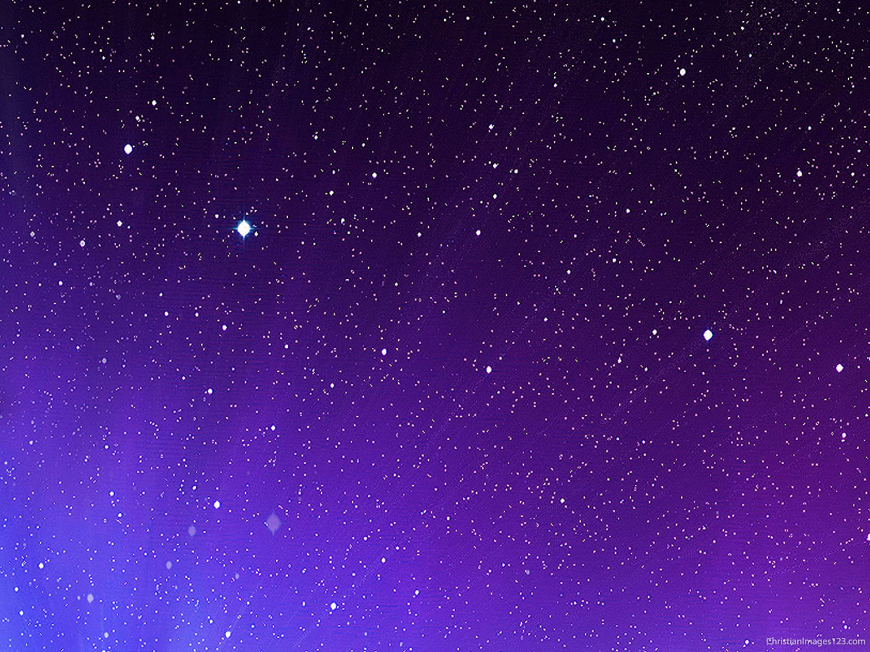
1992 Jason
vs.
2020 Jason

Slide 12
1992 Wichita Church
vs.
2020 Wichita Church

Slide 13
REPENT!

Slide 15
What keeps us from Re-Loving?

Slide 16
Remember +
Repent +
Re-Love =
Re-Connection

