Slide 1
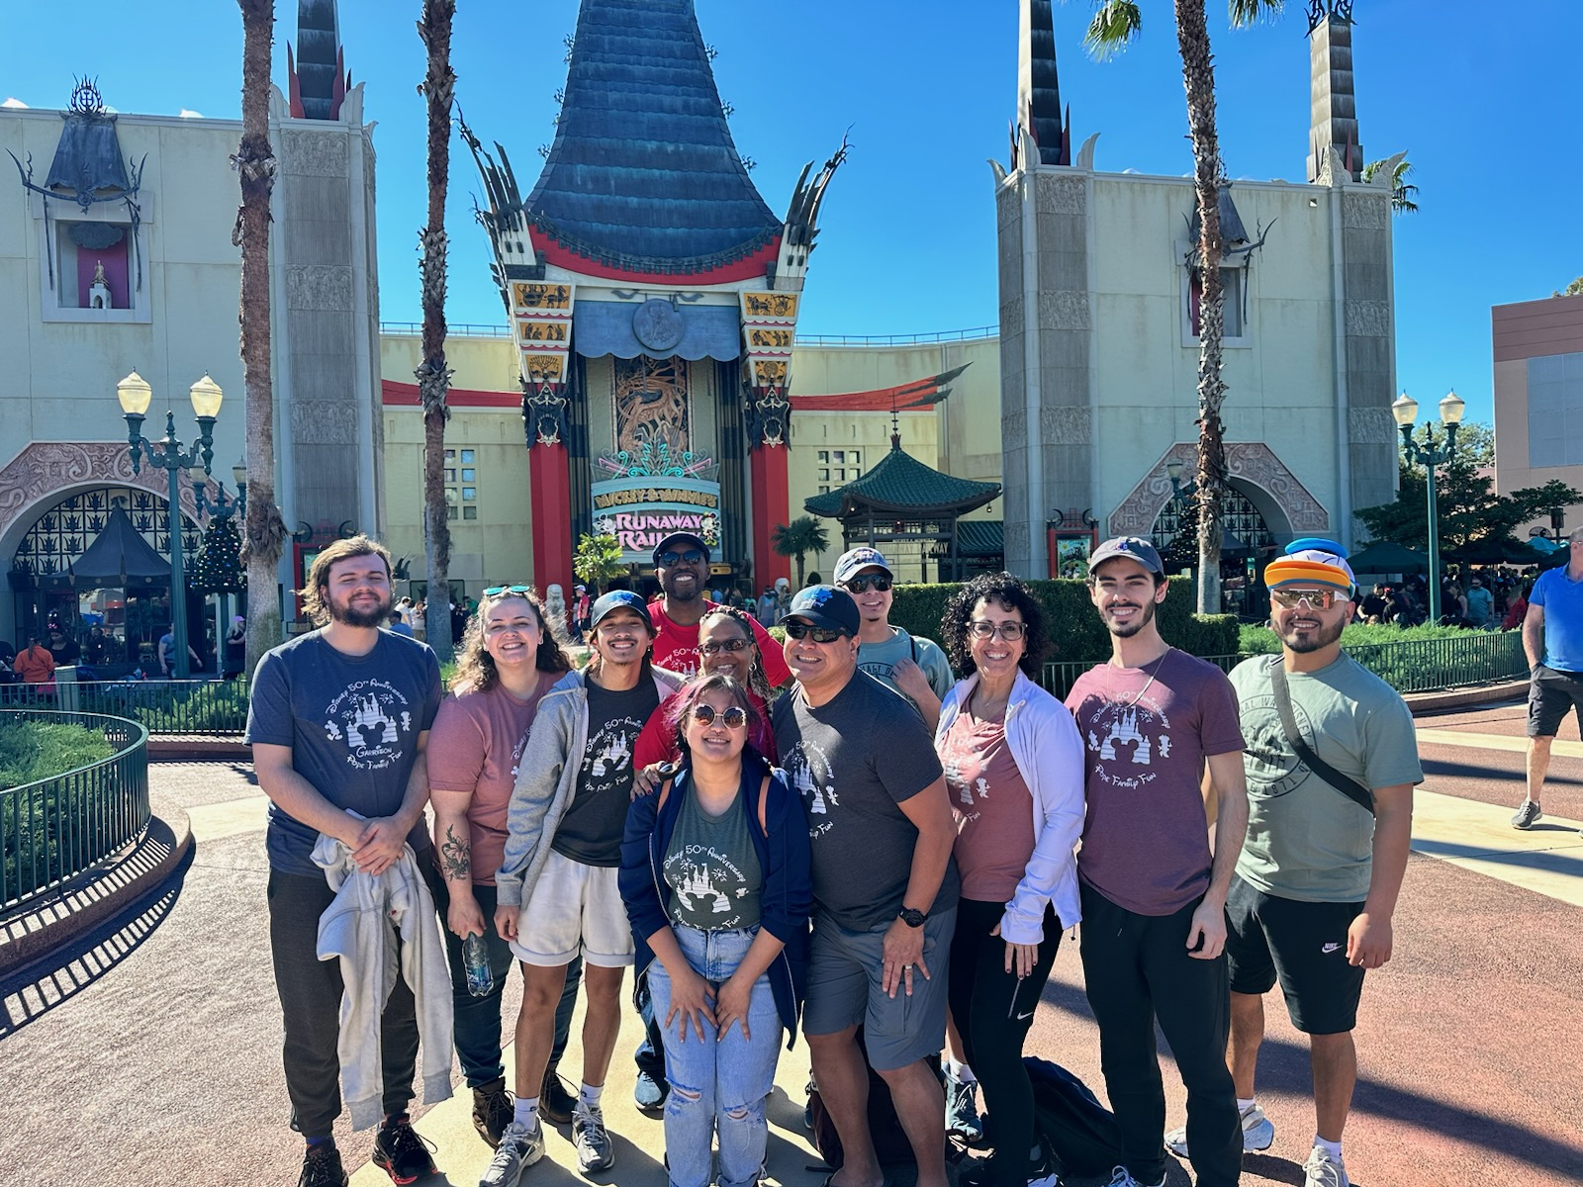
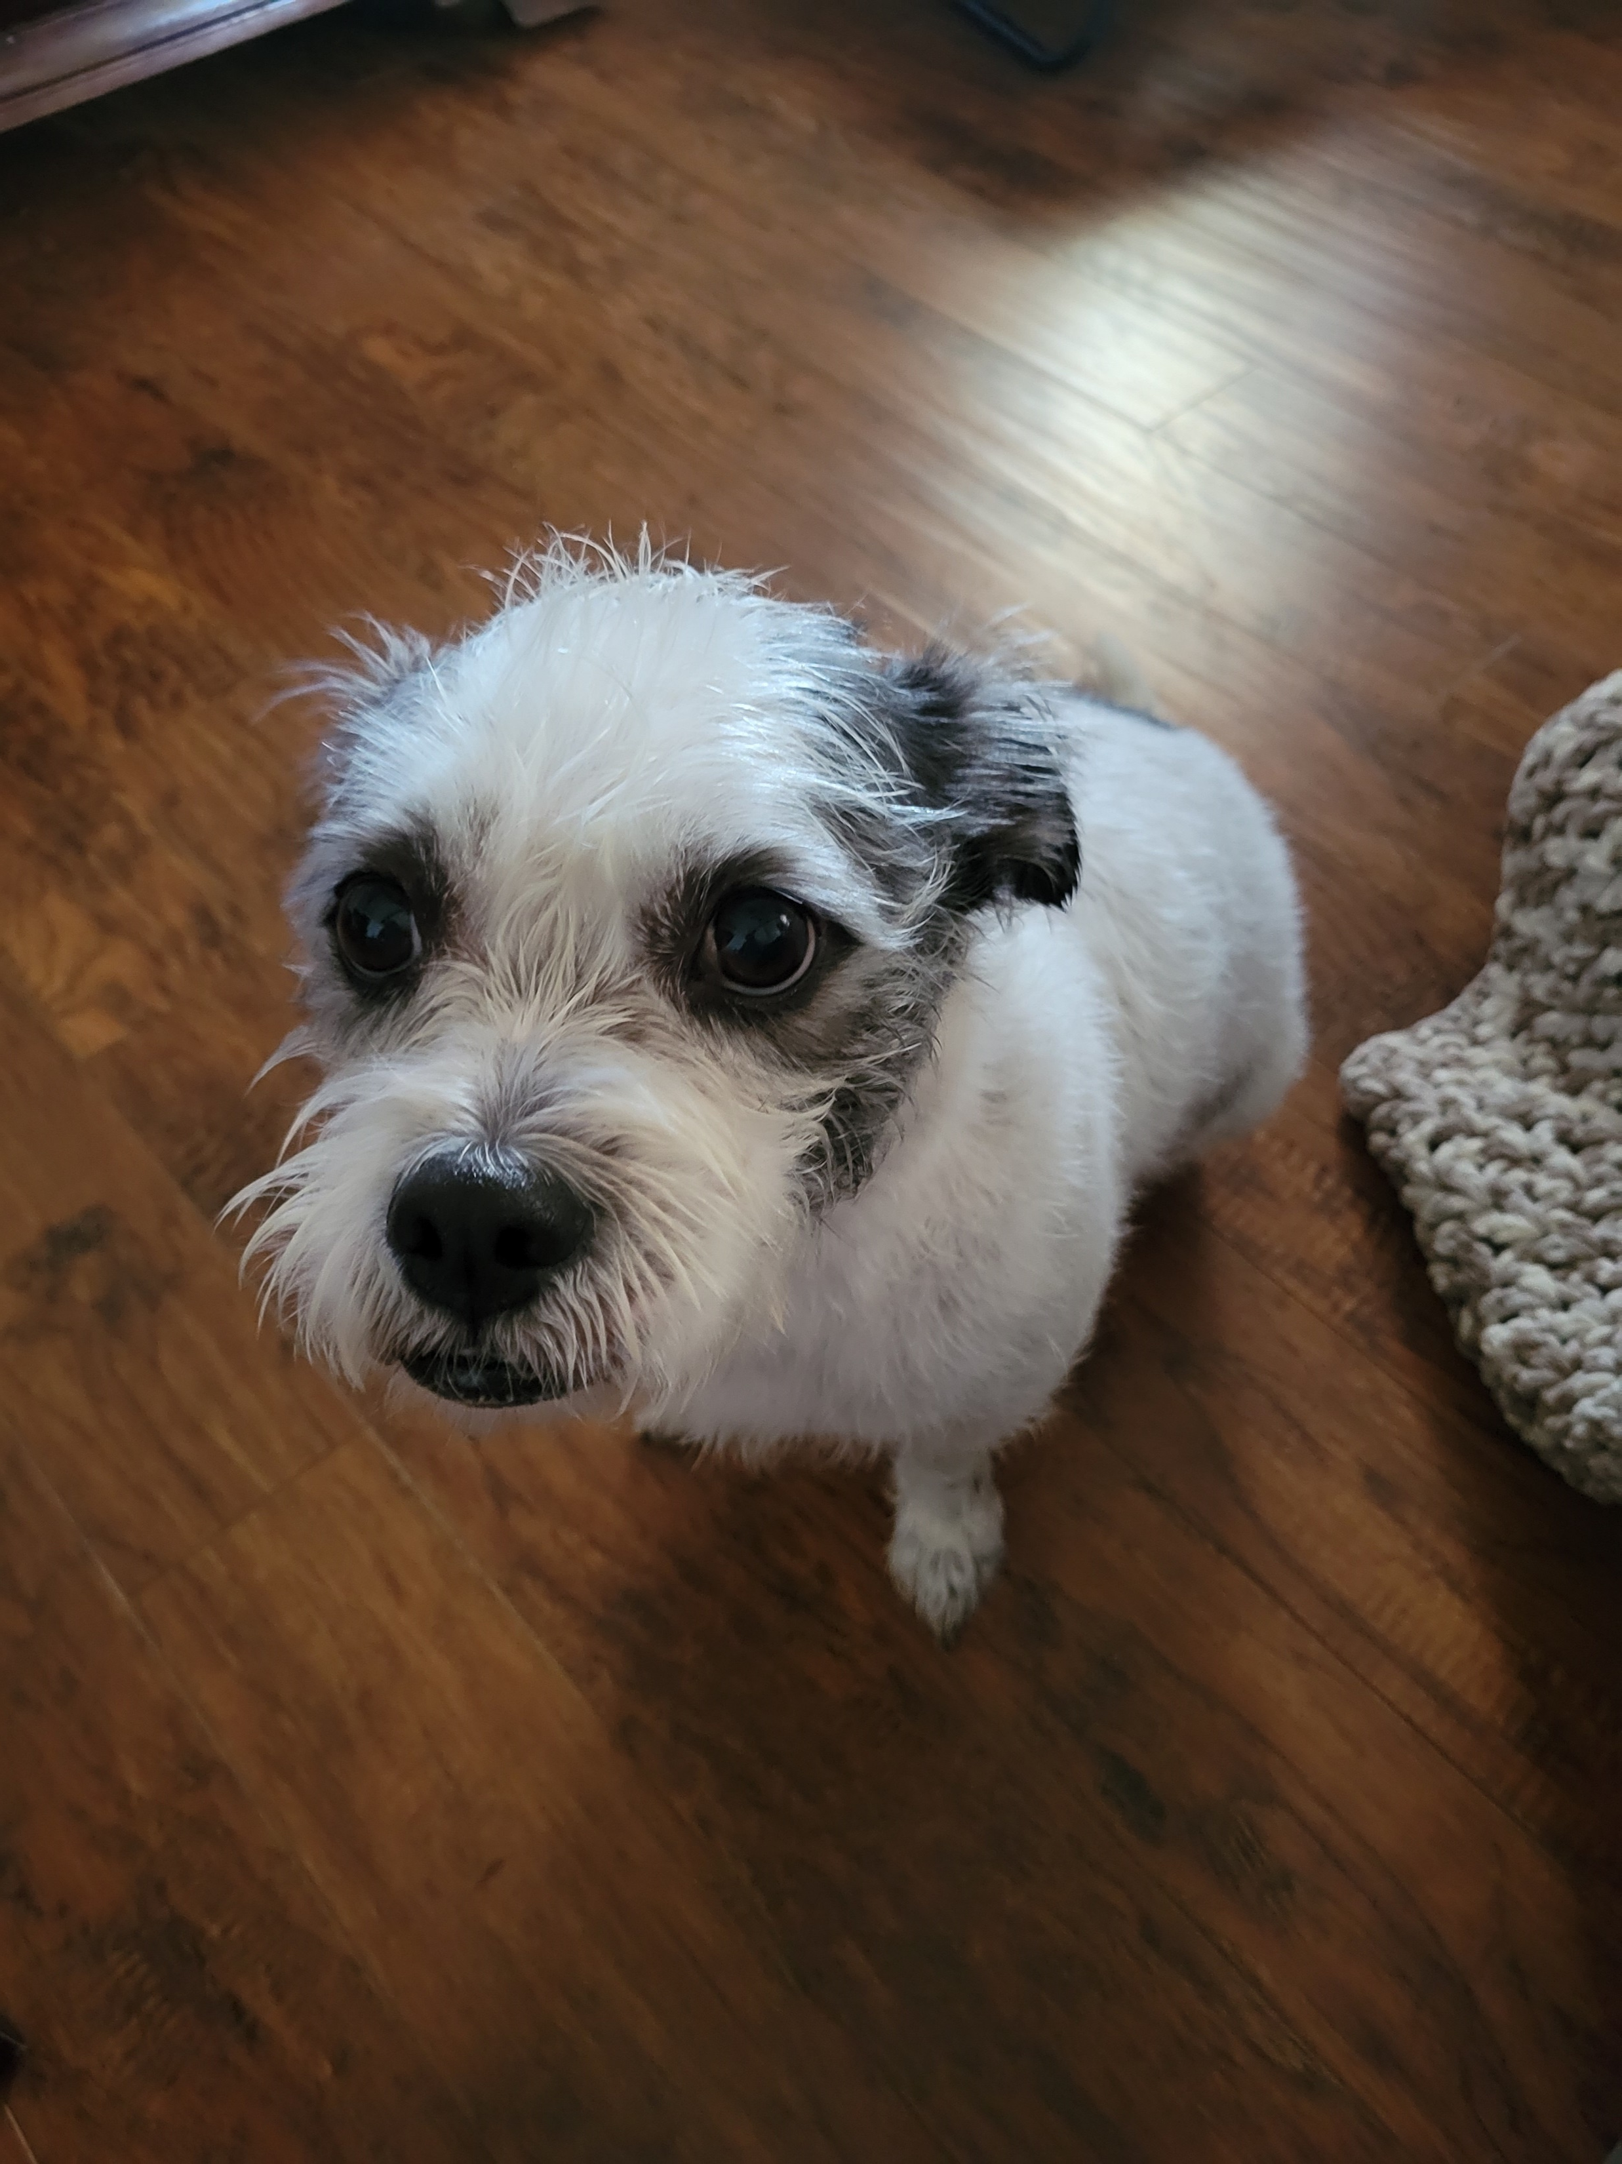
Ed Pope OKC Church

Slide 2
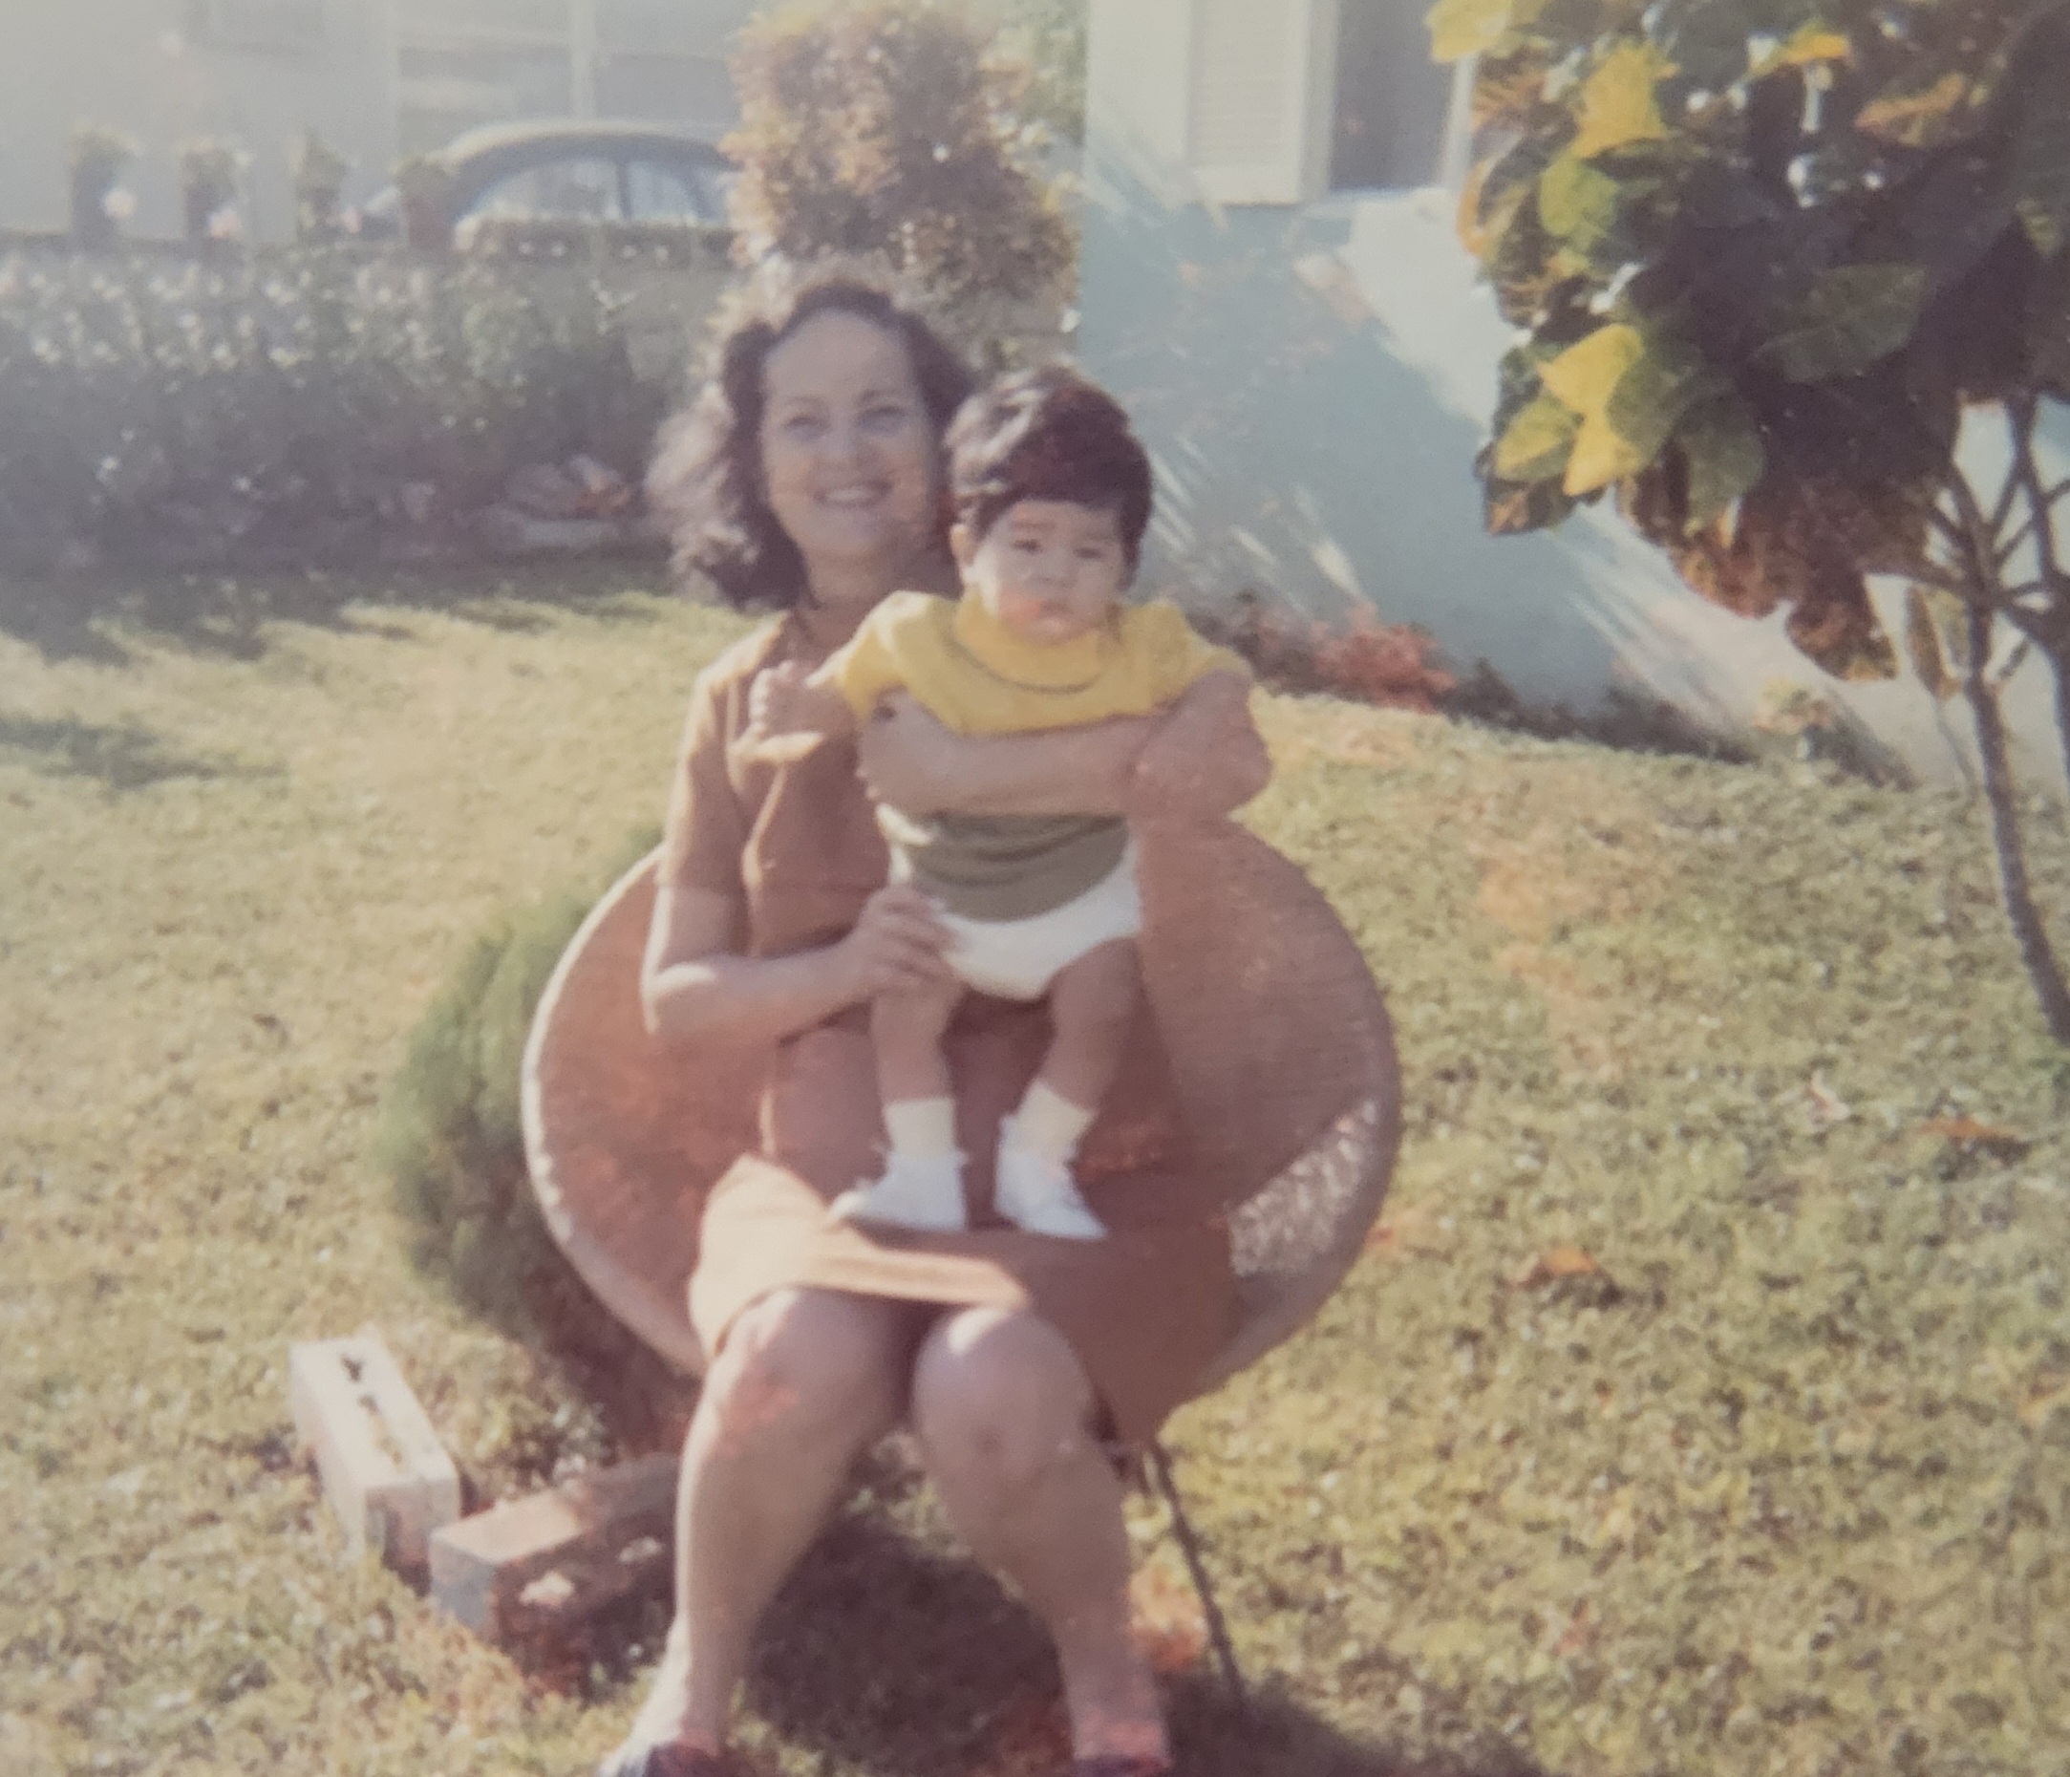
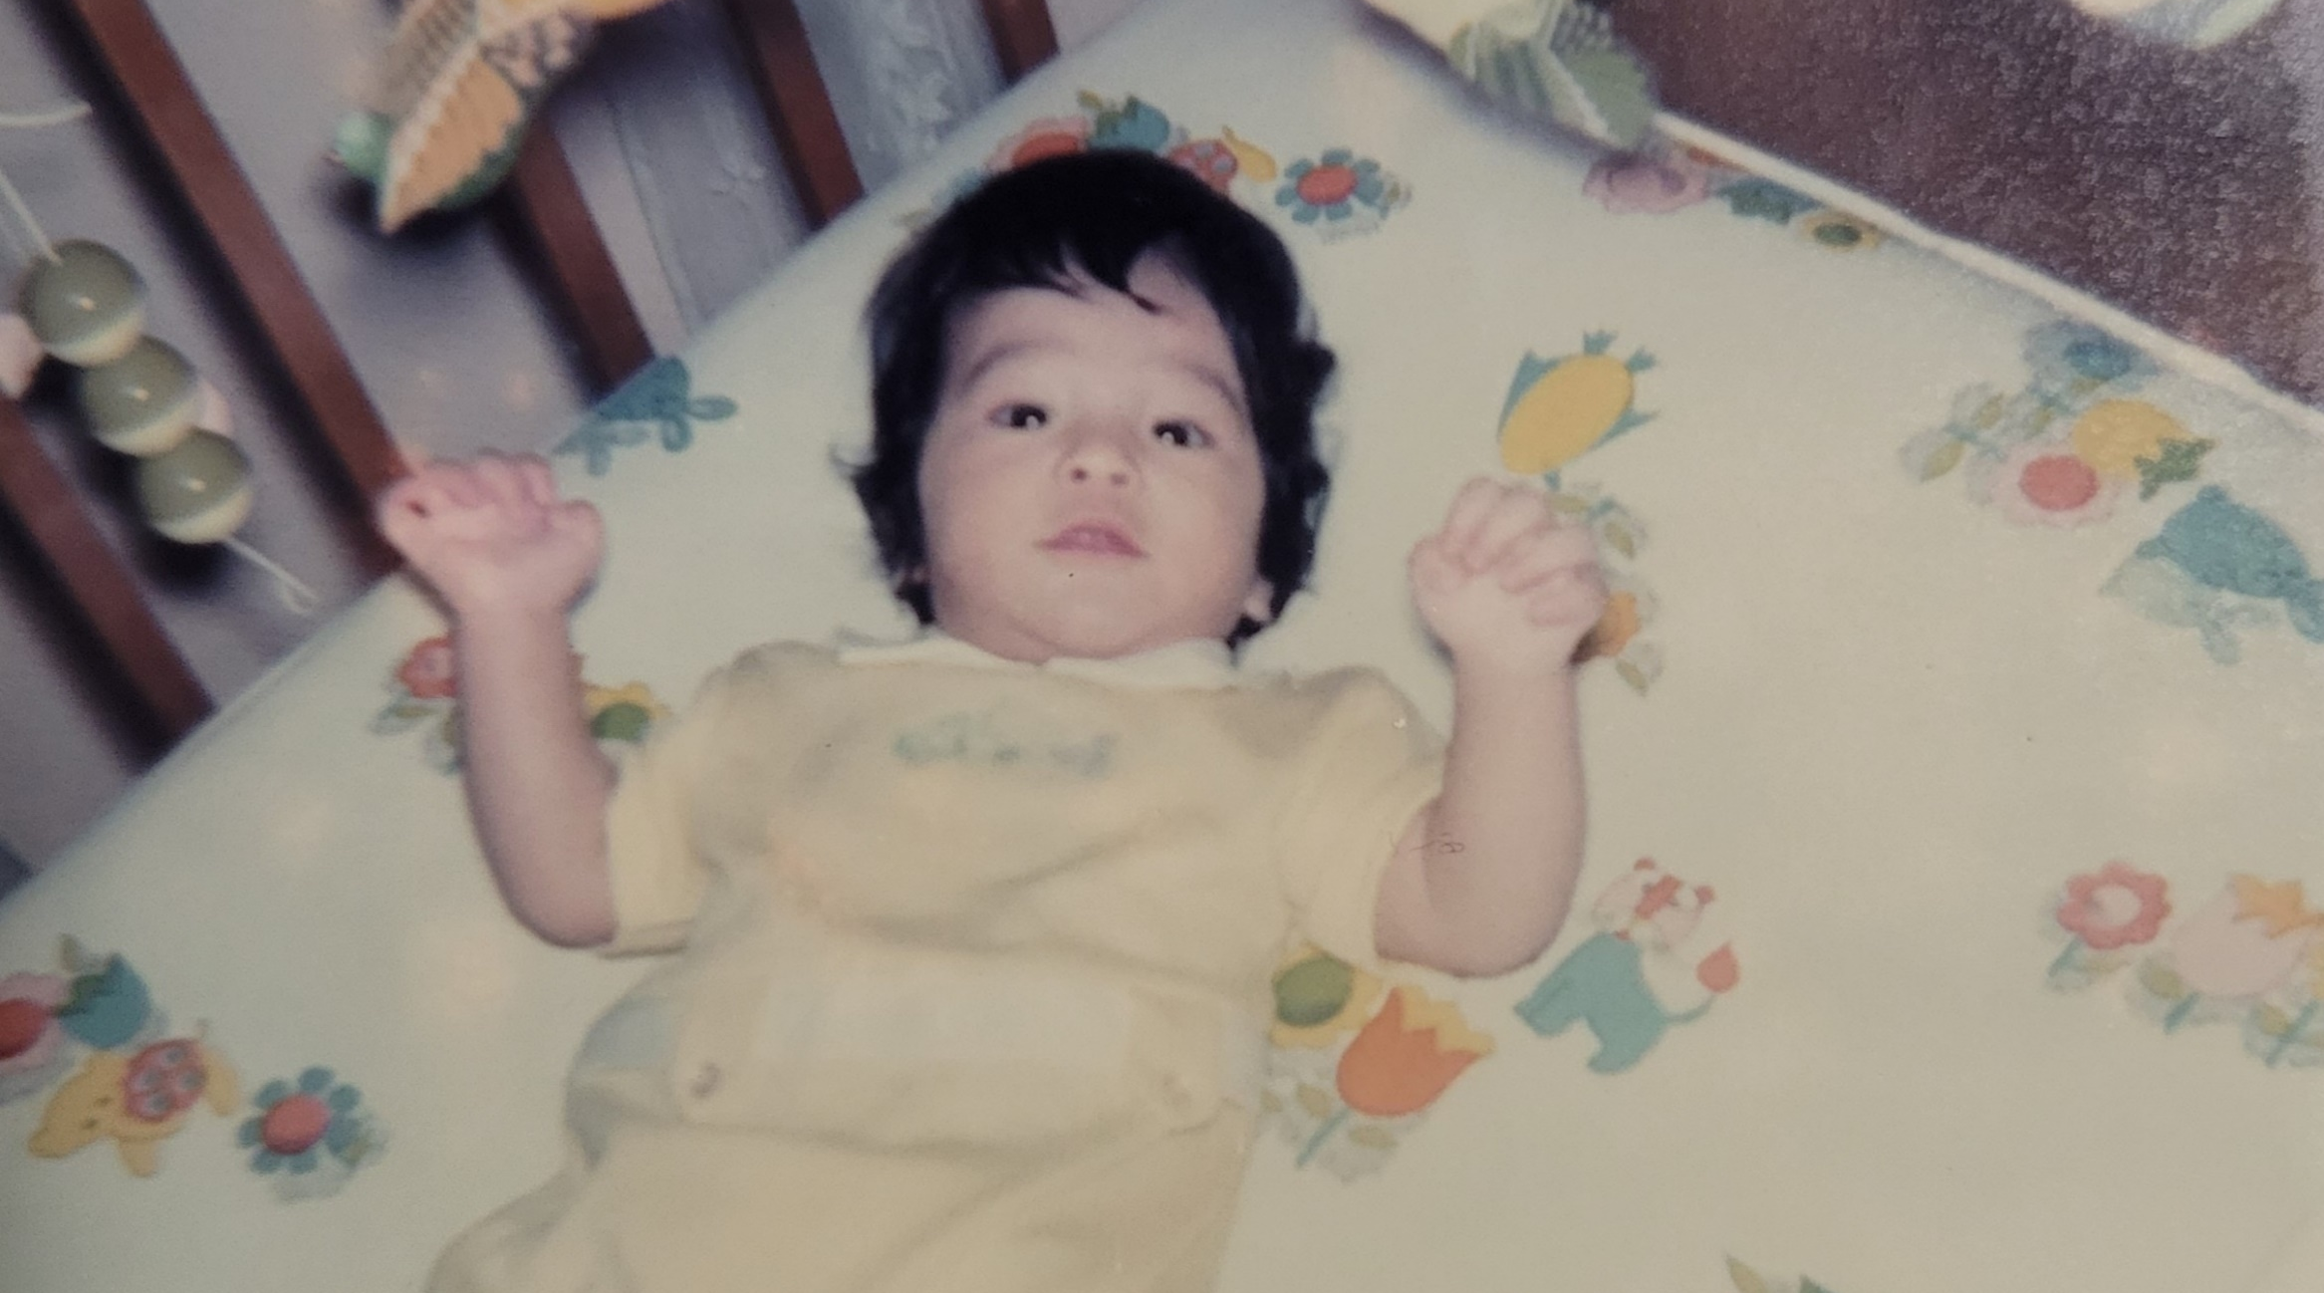
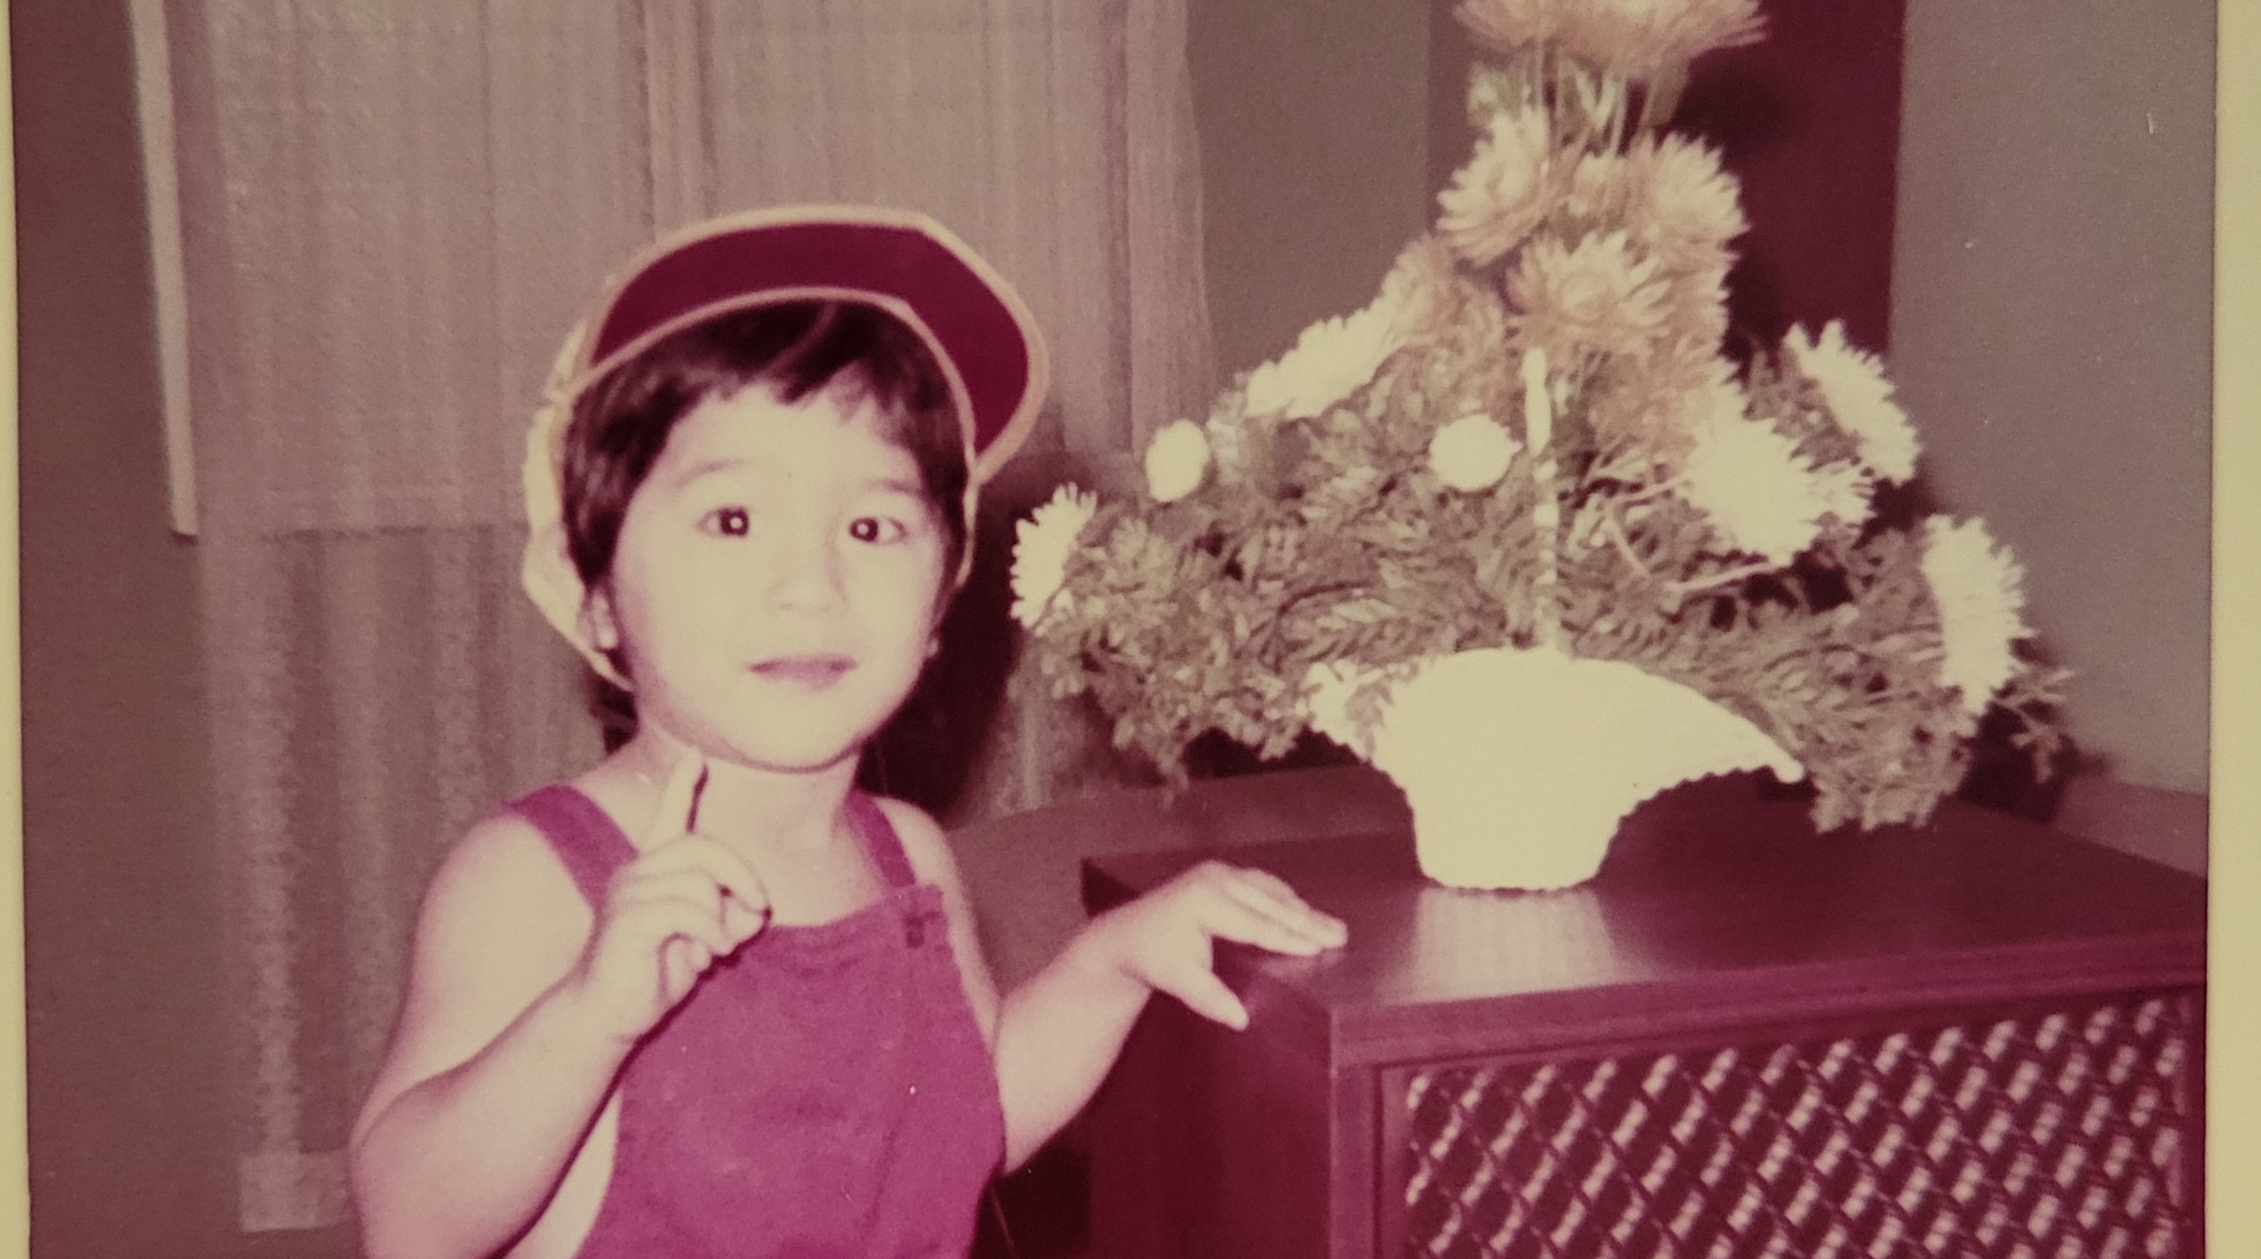

Slide 3
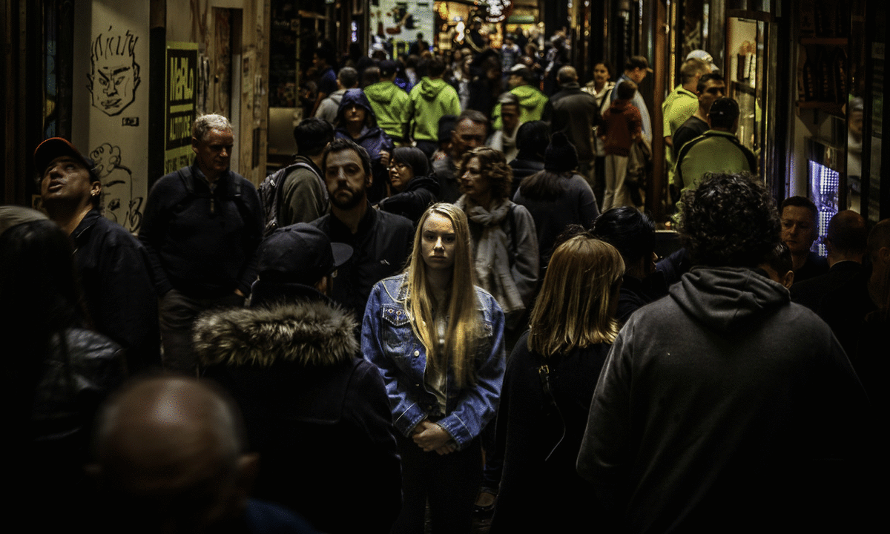
Alone in a crowded room

Slide 4
It’s Not good for man to be alone. Genesis 2:18

Slide 5
Where are you?

Slide 7
So let the sun come streaming in 'Cause you'll reach up and you'll rise again Lift your head and look around You will be found

